Slide 1


Slide 2
1. In 2010, only 15% of BEED and 25% of BSED graduates passed the LET. What should be done to prevent the low performance of graduates taking the LET?
Revise objective-setting instead of TOS competencies outcomes
Lower tuition fees in TEIs
Implement selective admission in TEIs
Review existing teacher education curriculum vis-vis TOS

Slide 3

REPUBLIC ACT NO. 7836
"Philippine Teachers Professionalization
Act of 1994"
An act to strengthen the regulation and supervision of the
Practice of teaching in the Philippines and prescribing a
Licensure Examination for Teachers and for other purposes.

Slide 4
2. By way of language medium, which is best for students of diverse cultural backgrounds?
Regional dialects
National language
English and Filipino
Multi-lingual teaching

Slide 5
3. How can schools effectively support out-of-school youths and the unemployed?
Set up job fairs
Make them parts of PTCAs
Hire them as non-teaching personnel
Provide livelihood training

Slide 6
4. What is the overall stream for education, growth and fulfillment in the teaching profession?
Merit and promotion
Lifelong career
In-service
Pre-service

Slide 7
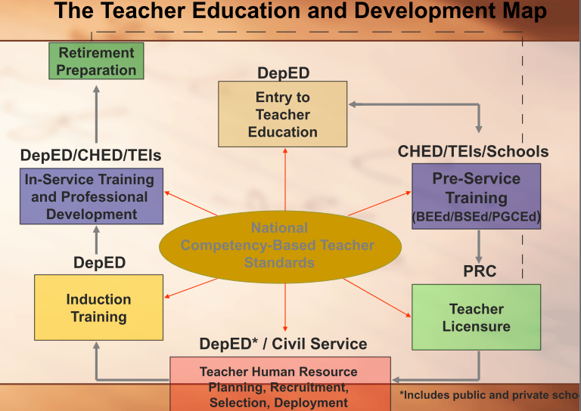

Slide 8
5. In the school, who is the key to the success or failure in teaching-and-learning, being the link between the child and the curriculum?
The teacher
The parent
The student
The principal

Slide 9
6. For teachers, what is the most laudable motive for participation in professional development programs?
Promotion and higher merit pay
Support for training programs
Optimal use of time and resources
Continuing professional growth

Slide 10
7. Of the following interventions, which is directly aimed at responding to the transitional gap between academic achievement and employment?
Deregulation of tuition fees
Voluntary accreditation of schools
School networking with business and industry
Identification of centers of excellence

Slide 11
8. What is the most effective way to deal with non-participating students who do not have interest in the lessons and their being part of class activities?
Give reminders on coming tests
Get help from guidance counselor
Introduce engaging activities, e.g role playing
Warn against not joining class work

Slide 12
9. What guideline should govern inflicting punishment?
Extra schoolwork is the best form of punishment
Punish at will
Abide by the school’s rules on punishment
Apply different standards for punishment

Slide 13
10. Classroom routines form the backbone of daily school activities, but which of the following is not covered by such routines?
Submission of work
Lesson content
Distribution of papers
Seating arrangement

Slide 14
O
S
Subject Matter
L
Learning Activities
E
Evaluation
Assignment
Objective
A

Slide 15
11. What kind of humor is inappropriate for defusing tension in the classroom?
Funny bloopers
Folk humor
Comic humor
Sex jokes

Slide 16
12. What rule should be followed for lighting SPED classroom?
Light coming from the right side of students
Very well lighted classroom room
Standard yet adequate
Dark classroom

Slide 17
13. How can the moral attitude of student Dona be judged as she goes to Church confession every day to be washed of all sins?
Pharisaical
Strict
Scrupulous
Callous

Slide 18
14. For gender fairness, what is one name which can replace reference to transvestic queens?
Dyke
Poofer
Transgender
Third sex

Slide 19
15. Among the following terms in technology, which has the broadest concept of technology for the whole educative system?
Computer technology
Audiovisuals
Instructional technology
Educational technology

Slide 20
16. In the process of integrating technology in instruction, which of the following points to the highest kind of cognitive skills desired?
Nurturing of class teamwork
Engendering meaningful learning
Introducing social learning
Developing metacognition

Slide 21
17. What quality makes digital visual materials better describes as “virtual reality?”
Self-composed
Color and tone
Lifelike
Depth of field

Slide 22
18. What is known as getting the meaning of a new unfamiliar word by looking for hints from surrounding words in a sentence or paragraph?
Context clues
Syntactic clues
Semantic clues
Graphophonic clues

Slide 23
19. How can lessons be made more meaningful by way of learning continuity?
Add value to content
Introduce new content
Stress retention of facts
Relate present with past lesson

Slide 24
20. Among cognitive objectives, what refers to the transfer of knowledge from one concept to another?
Synthesis
Application
Analysis
Comprehension

Slide 25
21. Which of the following is the most reliable tool for determining the students’ ability to write?
Portfolio assessment
Scoring rubric
Interview of students
Self-assessment

Slide 26



RUBRICS
A tool used to interpret
and grade students' work against criteria and standards.

Slide 27
Consists of a single scale with all criteria.
A rating score for each criterion.
HOLISTIC
ANALYTIC

Slide 28
22. How can automated checking help in improving reliability?
Ease in checking
Cost saving
Objective scoring
Time consuming

Slide 29
23. Using the Likert Method of summative scale, what is the mean for scale ratings (10, 7.5, 5, 2.5 and 0)?
2.5
5
7.5
10

Slide 30
24. What is meant by a difficulty index of one (1) for a test item?
Item is extremely difficult
Item is extremely easy
Item should be retained
Item is not valid

Slide 31
25. Teacher Louis found out that more from the lower group got item #16 correctly in his item analysis. This means that the test item has:
Low validity
High reliability
Negative discriminating power
Positive discriminating power

Slide 32

DISCRIMINATION INDEX
More from the upper group got the correct answers
Retain
POSITIVE
NEGATIVE
More from the lower group got the correct answers
Reject

Slide 33
26. What does the Teacher Education Development Program signify as a prerequisite for employment of teachers in basic education schools?
Job interview for teacher applicant
Licensure examination for teachers
Induction of new teachers
National standard competencies among teachers

Slide 34

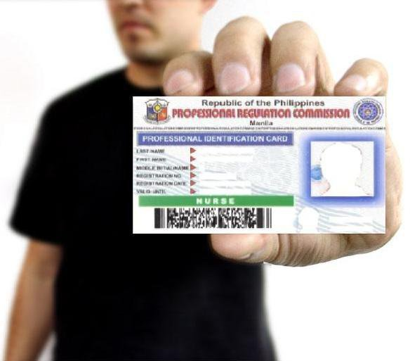
The method by which a state holds the professional teacher accountable for safe practice to citizens of that state.
ICENSURE
TEACHER

Slide 35

LICENSURE BY EXAMINATION
LICENSURE BY ENDORSEMENT
The process by which an individual who has completed an approved teacher’s program seeks initial licensure by successfully passing a standardized competency examination
The process by which an
individual who is duly licensed as a registered professional teacher under the laws of one country has his or her credentials accepted and approved by another country.
LICENSURE PROCESS

Slide 36
27. Is membership to the accredited professional organization for teachers mandatory for all LET passers?
No
Yes, when the teacher is already teaching
Yes
Only for LET passers who are not repeaters

Slide 37


National Organization of
Professional Teachers, INC
NOPTI is a non-profit, non-political, and non-stock Corporation. RA 7836 provides that “the teaching profession shall be integrated into national organization” and was recognized as the only accredited professional organization for teachers in the country.
Not mandatory but is encouraged.
VISION:
To be the premier teachers organization in the Philippines dedicated to the realization of the highest quality education for all Filipinos…
It is not a labor but a PROFESSIONAL Organization
MISSION
To contribute to the development of a strong progressive nation and global quality education…
Open to public and private teachers.
Accrediting body for CPD programs

Slide 38
28. Teacher Kevin has not practiced his profession for the past five years. Can he go back to teaching immediately?
Yes, if nobody can take his place
No, unless he has enrolled in refresher course of 12 units
No
Yes

Slide 39

Sec 2. Sec 26 (b) of RA 9293
Professionals who have not practiced for 5 years
Shall take at least 12 units of education courses.
6 units of content courses
6 units of pedagogy
Notes:
Sec. 20 Registration by Reciprocity: A certificate of registration/ professional license may be issued without examination to nurses registered under the laws of foreign country or state; Provided, that the requirements for registration or licensing of nurses in said country are substantially the same as those prescribed under this Act. Provided further, that the laws of such state or country grant the same privileges to registered nurses of the Phil on the same basis as the subjects or citizens of such foreign state or country.

Slide 40
29. Can Manny Pacquiao be given a special permit to teach boxing in a special school?
No, he is not a teacher education graduate
No, he has not passed the LET
Yes, he is a graduate of ALS
Yes, he has excelled and gained international recognition

Slide 41
Sec 2. Sec 26 (b) of RA 9293
A Special Permit for teaching…
May be issued to a person who has excelled and gained international recognition
And may also be issued to widely acknowledged expert in his field of specialization.
Notes:
Sec. 20 Registration by Reciprocity: A certificate of registration/ professional license may be issued without examination to nurses registered under the laws of foreign country or state; Provided, that the requirements for registration or licensing of nurses in said country are substantially the same as those prescribed under this Act. Provided further, that the laws of such state or country grant the same privileges to registered nurses of the Phil on the same basis as the subjects or citizens of such foreign state or country.

Slide 42
30. To whose responsibility is assigned by the Philippine Constitution to the establishment, maintenance and support of complete, adequate, and integrated system of education?
The citizens
The legislators
The state
The local governments

Slide 43


Section 2. The State shall:
“(1) Establish, maintain, and support a complete, adequate, and integrated system of education relevant to the needs of the people and society”

Slide 44
31. What program aims to reduce the gap between low social status and educational opportunities for deserving students?
National Achievement Test
Education Service Contracting Scheme
Annual Fiscal Allocation
National College Admission Examination

Slide 45
Education Service Contracting Scheme
The ESC program bestows grants to ‘poor but deserving’ elementary graduates to attend private secondary schools subcontracted by the government.
Partnership program by DepEd with private schools.
Aim is to decongest overcrowded public schools.
Legal basis is RA 8545 (Expanded GASTPE)

Slide 46
Section 2. The State shall:
“(3) Establish and maintain a system of scholarship grants, student loan programs, subsidies, and other incentives which shall be available to deserving students in both public and private schools, especially to the underprivileged.”

Slide 47
Section 11. Scholarships, grants-in-aid, or other forms of incentives shall be provided to deserving science students, researchers, scientists, inventors, technologists, and specially gifted citizens.

Slide 48
32. What is the primary reason for the 1987 Constitution’s adoption of a national language?
Counteract elitism
Go away with colonial mentality
Facilitate communication among diverse linguistic groups
Show the role of Tagalogs in the Hispanic revolution

Slide 49
Section 6. Subject to provisions of law and as the Congress may deem appropriate, the Government shall take steps to initiate and sustain the use of Filipino as a medium of official communication and as language of instruction in the educational system.

Slide 50
33. When should teachers support one another?
At all times for whatever cause
When they dialogue with administration
When there is rift among teachers
When the best interest of learners is at stake in a controversy

Slide 51
CODE OF ETHICS FOR PROFESSIONAL TEACHERS
Section 1. Every teacher shall actively insure that teaching is the noblest profession, and shall manifest genuine enthusiasm and pride in teaching as a noble calling.

Slide 52
Code of Ethics for Professional Teachers
Article V Sec 1:
When the best interest of the learners, the school, or the profession is at stake in any controversy, teachers shall support one another.

Slide 53
34. What does the traditional curriculum and mass education lack that the progressive curriculum can deliver?
Authoritarian role of the teacher
Collective discipline
Value for individualization
Rigid system of grading

Slide 54
35. What is the hidden goal of students who refuse to cooperate or participate in class activities?
To seek power
To get attention
To isolate self
To get revenge

Slide 55
36. Among mistaken goals in the Acceptance Approach to discipline, what happens when students are not getting the recognition they desire, continually seek help, and refuse to work unless the teacher hovers over them?
Attention getting
Withdrawal
Revenge seeking
Power seeking

Slide 56
Attention-seeking
Keeps others busy;
Power-seeking
Bossy
“I want to help.”
Revenge-seeking
Want to get even
Isolation/Assumed Inadequacy
“Notice me.”
“Help me.”
Low self-esteem
“Show me small steps.”

Slide 57
37. What kind of help can most likely be effective for the shy and timid students?
Encouragement
Persistent counseling
Tolerance
Disciplined guidance

Slide 58
38. Which expresses threat of punishment with least severity?
“Report early tomorrow or you’ll be punished by cleaning school grounds.”
“I will send you to the principal’s office, or else have your parents see the principal.”
“You will get shortened recess or else receive more severe punishment.”
“I will work for your removal from class.”

Slide 59
39. Following the principles for punishing students, which of the following is the LEAST desirable strategy for classroom management?
Punishing while clarifying why punishment is done
Punishing while angry
Punishing the erring student rather than the entire class
Give punishment sparingly

Slide 60
40. Of subcategories of teacher movement behavior, what is happening when the teacher goes from topic or activity to other topic or activities, lacking clear direction and sequence of activities?
Truncation
Dangle
Thrust
Flip-flop

Slide 61

Multi-tasking
OVERLAPPING

Slide 62

Teacher leaves a topic without having finalized it
DANGLING

Slide 63

Teacher is teaching a lesson on one topic, but then inserts unrelated material from a previous lesson.
FLIP-FLOP

Slide 64

Ending the topic abruptly.
TRUNCATION

Slide 65

Gets easily distracted.
STIMULUS-BOUNDED

Slide 66
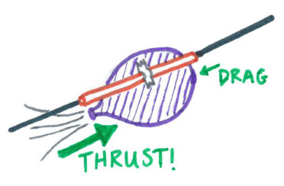
Teachers fail to give clear, well-worded directions when group attention was upon them.
THRUST

Slide 67

Pace of a lesson.
MOMENTUM

Slide 68

Allow group to actively participate.
GROUP FOCUS

Slide 69

Avoiding dangle.
SMOOTHNESS

Slide 70
41. What should be the immediate reaction to a student angered and making personal remarks?
Get physical on the student
Leave the room
Meet anger with anger
Get student to calm down

Slide 71
42. As preventive measure for classroom discipline, the teacher may restructure the program. How is this not done?
Teach again lessons difficult to understand
Remove tension level before processing with lesson
Modify lesson
Skip whole lesson unit altogether

Slide 72
43. Which of the following is not an indicator of a supportive learning environment?
Student’s responsibility for learning
Warm and friendly environment
Increase in student-teacher bonding
High use of audiovisuals

Slide 73
44. Among the components in the instructional framework for learning strategies, which is demonstrated by teacher Ana who assigns homework for students to do on their own?
Independent practice
Review
Consolidation
Modeling

Slide 74
45. What is the framework in providing students with templates and explaining the steps for developing a research paper?
Consolidation
Modeling
Review
Guided practice

Slide 75
Shows students exactly what expectations are and gives step by step instructions for skills/tasks such as working a problem.
MODELING

Slide 76
Students practice with teacher or peer guidance until they are proficient in the skill.
GUIDED PRACTICE

Slide 77
I do.
We do together.
You do together.
You do alone.
Modeling
Guided Practice
Peer practice
Independent Practice

Slide 78
46. In a problem-based learning group, who leads the discussion for achieving desired aims?
Recorder
Observer
Team members
Leader

Slide 79
Leader
Facilitator
Recorder
Members

Slide 80
VERTICALLY ORGANIZED TEAM
HORIZONTALLY ORGANIZED TEAM
LEADER DECIDES
MAJORITY DECIDES

Slide 81
47. What describes the inductive teaching-learning (TL) method?
T-L individual ideas to general ideas
T-L general ideas applied to individual cases
T-L specific ideas to specific ideas
D. T-L general ideas to general ideas

Slide 82
48. In the learning to do pillar of new education, what is the enabling factor that can make the learner fully contribute to a peaceful and just society?
Knowledge
Skills
Insights
Values

Slide 83


Learning to Do demonstrates that in order to learn to live and work together productively and harmoniously, we must first find peace within ourselves, expand our acceptance & understanding of others, and continually strive towards living the values which enable us to contribute more fully to the development of a peaceful and just society.

Slide 84
49. Which organization advanced insights of “Learning to Treasure Within” for 21st century education?
Geneva International Conference
International Commission for the 21st Century
Education for All Initiative
Asia Pacific Regional Bureau

Slide 85
4 PILLARS of Education (UNESCO)
Know
Knowledge
Do
Be
Beliefs; values; be human
Live together
Skills; compe-tence
Knowledge and under-standing of self and others.

Slide 86
5TH Pillar
Learning to Transform Oneself and Society
-combination of the 4 pilalrs

Slide 87
50. What observation tests to the fact that the student’s motivation vary according to socio-cultural background?
Females mature earlier than boys
Genetic endowments may show gifted endowments among the young
Brains of boys are bigger and better than those of females
Children from low-income household meet more obstacles in learning

Slide 88
51. The world has become a global village. What sound practice is expected of teachers?
Ethnocentrism
Respect of diverse cultures
Ethnic cleansing
Xenocentrism

Slide 89
52. What is journal writing using the internet and useful for teachers who can publish lesson ideas to digital student readers?
Powerpoint
Instagram
E-mail
Blog

Slide 90
53. What is the purpose of support instructional materials in the classroom?
Replace teacher’s functions
Teach new lesson
Enhance learning
Speed up learning

Slide 91
54. With closeness to direct experience as standard, which one should a teacher choose?
Contrived experiences
Study trip
Dramatized experiences
Demonstration

Slide 92
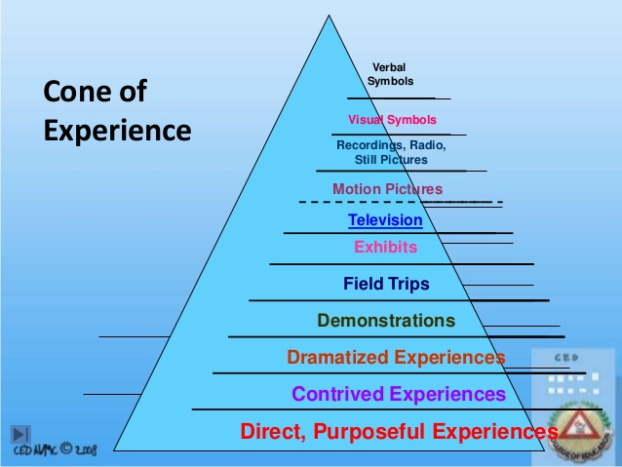

Slide 93
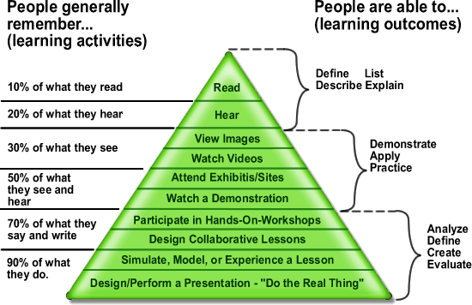

Slide 94
55. What provides the most direct type of learning, but is difficult to supply in the traditional classroom?
Real-life experience
Computer-assisted learning
Verbal symbolism
Multisensory instructional aids

Slide 95
56. How is the Venn diagram most useful in presentation of concepts?
Sequence of events
Comparison
Showing cause and effect
Presenting attributes

Slide 96
57. What visual aid is useful in showing the trend in temperature change from month-to-month?
Bar graph
Flow chart
Map
Drawing

Slide 97
58. Before the advent of technology and universal acceptance of diversity in the classroom, what was the paradigm of classroom management?
Procedures for self-discipline
Responsibility by everyone in the classroom
One-way interaction flow
Value for individualization

Slide 98
59. In outcomes based education, which of the following are not considered outcomes?
Products
Procedures
Portfolios
Performances

Slide 99
60. Teacher Ernie makes sure that he covers the essential subject content, while treating them sufficiency or in- depth. What guiding principle is he following for lesson preparation?
Balance
Feasibility
Significance
Self-sufficiency

Slide 100
61. What is the basic psychological principle in multicultural instruction?
High standards for achievement
Enrichment of cognitive potential
Individual differences
Motivated learning

Slide 101
62. In Grace Goodell’s Reading Skills Ladder, which is at the very bottom and needed to move up to the sequential ladder of reading skills?
Vocabulary building
Phonetic analysis
Basic sight words
Structural analysis

Slide 102
Basic sight words
Phonetic analysis
Structural analysis
Contextual clues
Vocabulary
Main idea
Supporting details
Conclusion
9. Facts
10. Parts of the book
11. Dictionary
12. Encyclopedia
13. Library
14. Private library
15. Mass media
16. Internet
GRACE GOODELL’S
READING SKILLS LADDER

Slide 103
63. In Erikson’s theory of development questionnaire, which affirmation does not belong to the stage of initiative vs. guilt?
People can be trusted
In difficulty, I will not give up
I feel what happens to me is the result of what I have done
I am prepared to take a risk

Slide 104


Erikson’s 8 Psychosocial Stages
1.Trust vs. Mistrust (0-18 mos.)
2.Autonomy vs Shame & Doubt (18 mos-3 yrs)
3. Initiative vs Guilt (3-5 yrs.)
4.Industry vs Inferiority (6-12 yrs)
5.Identity vs Role Confusion (12-18 yrs)
6.Intimacy vs Isolation (18-30 yrs)
7.Generativity vs Stagnation (30-60 yrs)
ULTIMATE FINAL COACHING 2014
8.Ego Integrity vs Despair (65 –death)

Slide 105
PSYCHOSOCIAL THEORY (Erik Erikson)
 | STAGE | AGE | VIRTUE
1 | Trust vs. Mistrust | 0-18 mos. | Hope
2 | Autonomy vs. Shame and Doubt | 18-3 yrs | Will
3 | Initiative vs. Guilt | 3-6 | Purpose
4 | Industry vs. Inferiority | 6-12 | Competence
5 | Identity vs. Role Confusion | 12-18 | Fidelity
6 | Intimacy vs. Isolation | 18-24 | Love
7 | Generativity vs. Stagnation | 24-54 | Care
8 | Ego Integrity vs. Despair | 55 & Up | Wisdom
???
???
???
???
???
???
???
???
???
???
???
???
???
???
???
???

Slide 106
COGNITIVE THEORY (Jean Piaget)
 | STAGE | AGE
1 | Sensorimotor | 0-2
2 | Pre-Operational | 2-7
3 | Concrete Operational | 7-11
4 | Formal Operational | 11-16
???
???
???
???

Slide 107
PSYCHOSEXUAL THEORY (Sigmund Freud)
 | STAGE | AGE
1 | Oral | 0-2
2 | Anal | 2-4
3 | Phallic | 4-6
4 | Latency | 6-12
5 | Genital | 12 and up
???
???
???
???
???

Slide 108
64. Piaget’s Principles of cognitive learning, what is centration that likely causes mistakes in the learning process?
Admitting other perspectives
Being limited to a single point of view
Seeing through various perspectives
Allowing several points of views

Slide 109
65. In Piaget’s Concrete-Operational stage in cognitive development, which refers to the ability to order or arrange things logically on dimension such as weight, volume, or size?
Conservation
Reversibility
Decentering
Seriation

Slide 110
66. In Piaget’s Cognitive Concepts, what is the term of achieving proper balance to avoid discrepancy in perception and understanding?
Schema
Assimilation
Accommodation
Equilibrium

Slide 111
67. Someone said, “Experience without theory is blind, but theory without experience is mere intellectual play.” This means that:
Theory and experience must go hand-in-hand
Theory is more important than experience
Experience is more important than theory
One can stand without the other

Slide 112
68. Which of the following is not among the ways to advance metacognition?
Learn to organize thoughts
Assess our thinking
Learn how to study
Accept new knowledge

Slide 113
69. What is the quality of lesson content that gets the active attention of learners?
Interest
Balance
Feasibility
Self-sufficiency

Slide 114
70. Teacher Eli observed that student Edna is behind in her development with classmates in Grade Four. What most likely made him make this observation?
Her not achieving a feminine role in class
Her not assuming social responsibility
Her being emotionally independent from parents
Her not getting along with age-mates

Slide 115
71. What aspect of lesson content is important in the process of metacognition?
Content pattern
Content data
Content construct
Content meaning

Slide 116
72. Of the following, which is an instance when teachers lead students toward the metacognition?
Explaining learning objectives
Outlining parts of a lesson
Asking students to predict outcomes
Introducing topic of discussion

Slide 117
73. How is Plato’s contemplative use of the mind best characterized?
Creative
Interactive
Rote or routine
Introspective

Slide 118
74. On clusters of meaningful learning activities, which does not belong to bodily-kinesthetic learning activities?
Story telling
Hands-on demonstration
Dance
Role-playing

Slide 119
75. Which is the ability to know without being frustrated by ambiguous ideas?
Focus
Tolerance
Shaping
Intuition

Slide 120
76. Of the following classroom activities, which best relate to child visual learning and development?
Drawing and coloring
Singing and acting
Textbook reading
Games and sports

Slide 121
77. Which of the following manifestations among students show they are high in spatial intelligence?
Drawing and sketching
Classifying natural objects
Setting goals
Making calculations

Slide 122
78. What is the foundation of all cognitive objectives that paves the way for higher thinking skills?
Comprehension
Analysis
Synthesis
Knowledge

Slide 123
79. In his History class, teacher Naomi uses a current events IQ contest to determine champions in identifying people, places, and events. What learning objective/outcome does she aim to achieve?
Application
Knowledge or recall
Responding
Perpetual abilities

Slide 124
80. What is the cognitive ability to break and consider concepts through component parts?
Analysis
Shaping
Intuition
Synthesis

Slide 125
81. In his speech class, teacher Rod uses poetry dramatic reading by students, using movements (gestures, facial expressions, creative movements, etc). What learning objectives or outcome is he looking for?
Non-discursive communication
Reflex movements
Skilled movements
Characterization

Slide 126
Reflex Movements
To flex, to stretch, to straighten
Fundamental Movements
To crawl, to creep, to slide, to walk
Perceptual abilities
To catch, to bounce, to eat
Physical Abilities
To endure, to improve, to increase
Skilled
To waltz, to type, to play the piano
Non-discursive Communication
To gesture, to stand, to sit

Slide 127
82. On motivational assessment, which is the noblest motive for entering into a profession, e.g. teaching?
Promise of high pay and rewards
Social service
Prestige and position
Economic security

Slide 128
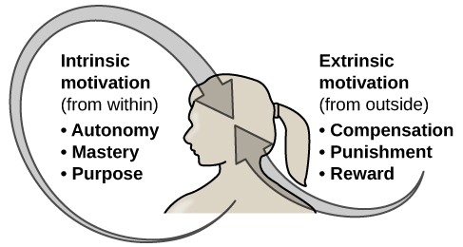

Slide 129
83. Of the following, which is the most conducive for authentic assessment?
Complex multiple-choice test
Performance drill
De-contextualized setting
Real world application

Slide 130
84. Of the following, which is the least authentic mode of student performance assessment?
Artistic production in art
Oral performance on communication
Experiment as a scientific method skills
Paper-pencil vocabulary test

Slide 131
85. Why is performance given the largest weight in TLE and MAPEH?
They have no affective aspect
They have no cognitive aspect
The written and quarterly test are given only 20% weight each
They are dominantly physical skill subject

Slide 132
86. What is the best way to assess a class presentation (song, dance or drama)?
Feedback
Interview
Observation
Rubrics

Slide 133
87. What kind of assessment helps teachers determine gaps in learning a subject matter?
Formative assessment
Diagnostic test
Summative assessment
Placement examination

Slide 134
88. What is determined by a criterion-reference test?
Performance on wide scale
Preferred level of specific skills
Performance on a moderate scale
Performance higher than other members of group

Slide 135
CRITERION
To determine whether each student has achieved specific skills or concepts.
PURPOSE
NORM
To rank each student with respect to the achievement of others in broad areas of knowledge.

Slide 136
CRITERION
Each individual is compared with a preset standard for acceptable achievement. The performance of other examinees is irrelevant.
SCORE INTERPRETATION
NORM
Each individual is compared with other examinees and assigned a score--usually expressed as a percentile, a stanine, etc.

Slide 137
89. Principal Rodriguez introduced machine-scored tests in his school. What factor in scoring does this add to make tests more reliable?
Objective scoring
Cost-saving
Ease in checking
Time-economics

Slide 138
90. The test questions in Teacher Dante’s test were confusing and subject to wrong understanding, especially to poorer students. What was wrong with the test?
Test items inappropriate for outcomes being measured
Inappropriate level of difficulty of items
Unclear directions
Ambiguity

Slide 139
91. Teacher Edna could not get it right, as her tests are either too easy or too difficult. What is wrong in this situation?
Unclear directions
Identifiable answer patterns
Inappropriate level of difficulty
Ambiguous items

Slide 140
92. For easier correction of his test, Teacher Edward prepared the True and False items in alternating 1, 3, 5, 7 etc. True, and 2, 4, 6 etc. False. What is wrong with the test in terms of Usability?
Improper arrangement of items
Identifiable pattern of answers
Ambiguity
Poorly constructed test items

Slide 141
93. Mrs. Ramos wants to test her student’s knowledge of the different places in the Philippines, their capitals, and their products. So she gave an essay test. If you were the teacher, will you do the same?
Yes, essay test can measure more than what the other tests can measure
Yes, essay is the best in measuring any type of knowledge
No, such method is inappropriate because essay is difficult
No, the giving of objective test is more appropriate than the use of essay

Slide 142
94. Ms. Espina would like to cover a wide variety of objectives in the quarterly examinations in her English class lesson on subject-verb agreement. Which of the following type of test is the most appropriate?
True-False
Multiple choice
Essay
Matching

Slide 143
95. What is true when student test results deviation is small?
Bell curve is relatively flat
Scores are tightly bunched together
Scores are toward both extremes
Scores are spread apart

Slide 144
96. What is the normal curve in the grade distribution of students in a class?
All have average grades
Most get average grades, few high and low
Most get high grades
Most get low grades

Slide 145
97. What can be said of student performance in a positively skewed score distribution?
Few students performed excellently
Most students performed well
Almost all students had average performance
Most students performed poorly

Slide 146
98. What does it mean to state that the difficulty index of a test item is one (1)?
The test item is extremely easy
The test item is not valid
The test item is very good and should be retained
The test item is very difficult

Slide 147



DIFFICULTY OR FACILITY INDEX
This is a measure of how easy or difficult is a question for quiz-takers.

Slide 148
DIFFICULT
EASY
Percentage of students who answered the item correctly.
DIFFICULTY INDEX

Slide 149
99. In preparing classroom tests, which of the following checklist is the last among steps in tests preparation?
How are the test scores to be tabulated?
Have I prepared a Table of Specifications?
How are the test results to be reported?
How is the objective item to be scored?

Slide 150
100. What is the direct advantage of test result in tests and quizzes?
Basis of students’ level of accomplishment
Indicator of student motivation
Demonstrates proof of overall performance
Indicator of learner’s performance in subject areas

